Slide 1
Module 13: Query Processing

Slide 2
Outline
Overview
Measures of Query Cost
Join Operation

Slide 3

Basic Steps in Query Processing
1. Parsing and translation
2. Optimization
3. Evaluation

Slide 4
Basic Steps in Query Processing (Cont.)
Parsing and translation
  Translate the query into its internal form. This is then translated into relational algebra.
  Parser checks syntax, verifies relations
Optimization
  Come up with a query execution plan
Evaluation
  The query-execution engine takes a query-evaluation plan, executes that plan, and returns the answers to the query.

Slide 5
Optimization
A relational algebra expression may have many equivalent expressions
  E.g., σ_{salary<75000}(∏_{salary}(instructor)) is equivalent to
  ∏_{salary}(σ_{salary<75000}(instructor))
Each relational algebra operation can be evaluated using one of several different algorithms
  Correspondingly, a relational-algebra expression can be evaluated in many ways.
Annotated expression specifying detailed evaluation strategy is called an evaluation-plan.
  E.g., can use an index on salary to find instructors with salary < 75000,
  Or, can perform complete relation scan and discard instructors with salary ≥ 75000

Slide 6
Optimization (Cont.)
Query Optimization: Amongst all equivalent evaluation plans choose the one with lowest cost.
  Cost is estimated using statistical information from the
  database catalog
    For example, number of tuples in each relation, size of tuples, etc.
In this module we study
  How to measure query costs
  Algorithms for evaluating relational algebra operations
  How to combine algorithms for individual operations in order to evaluate a complete expression
  We study how to optimize queries; that is, how to find an evaluation plan with lowest estimated cost

Slide 7
Measures of Query Cost
Cost is generally measured as total elapsed time for answering query
  Many factors contribute to “time” cost
    Disk accesses,
    CPU,
    Network communication
Typically disk access is the predominant cost, and is also relatively easy to estimate. Measured by taking into account
  Number of seeks * average-seek-cost
  Number of blocks read * average-block-read-cost
  Number of blocks written * average-block-write-cost
    Cost to write a block is greater than cost to read a block
      data is read back after being written to ensure that the write was successful

Slide 8
Measures of Query Cost (Cont.)
For simplicity we just use the number of block transfers from disk and the number of seeks as the cost measures
  t_{T} – time to transfer one block
  t_{S} – time for one seek
  Cost for b block transfers plus S seeks
    b * t_{T} + S * t_{S}
We ignore CPU costs for simplicity
  Real systems do take CPU cost into account
We do not include in our cost formulae:
  The cost for writing output to disk.

Slide 9
Measures of Query Cost (Cont.)
Can reduce disk IO by using extra buffer space
  Amount of real memory available to buffer depends on other concurrent queries and OS processes, known only during execution
    We often use worst case estimates, assuming only the minimum amount of memory needed for the operation is available
Required data may be buffer resident already, avoiding disk I/O
  But hard to take into account for cost estimation

Slide 10
Algorithms for Relational Operation
Several different algorithms for implementing relational operations
  Select operation
  Join Operation
  Project operation
  Set operation
  Outer Join
  Aggregation
  Sorting
We cover here only the join operation
Notation:
  n_{r} denotes number of tuples in relation r
  b_{r} denotes number of blocks containing records from relation r

Slide 11
Join Operation
Several different algorithms to implement joins
  Nested-loop join
  Block nested-loop join
  Indexed nested-loop join
  Merge-join
  Hash-join
Choice based on cost estimate
    Our examples use student and takes and the following information:
  Number of records of :
    student: 5,000 takes: 10,000
  Number of blocks of
    student : 100 takes : 400
We assume that each relation fits on ONE single track (cylinder).

Slide 12
Nested-Loop Join
To compute the theta join r _{θ} s
for each tuple t_{r} in r do begin
for each tuple t_{s} in s do begin
test pair (t_{r},t_{s}) to see if they satisfy the join condition θ
if they do, add t_{r} • t_{s} to the result.
end
end
r is called the outer relation and s the inner relation of the join.
Requires no indices and can be used with any kind of join condition.
Potentially expensive since it examines every pair of tuples in the two relations.

Slide 13
Nested-Loop Join (Cont.)
  Best case scenario – there are sufficient number of buffers to hold both the relations in memory.
The estimated cost is
b_{r} + b_{s} block transfers, plus
2 seeks (each relation fits on one track/cylinder)
Consider our student/takes example:
  Number of records of student: 5,000 takes: 10,000
  Number of blocks of student: 100 takes: 400
The cost estimates are:
  500 block transfers,
  2 seeks

Slide 14
Nested-Loop Join (Cont.)
  Worst case scenario -- there is enough memory to only hold one block of each relation.
The estimated cost for block transfers:
n_{r} ∗ b_{s} + b_{r}
  Each block in the inner relation s is read once for each block in the outer relation
The estimated cost for seeks:
n_{r} + b_{r} Each relation fits on one track/cylinder.
Consider our student/takes example:
  with student as outer relation:
    5,000 ∗ 400 + 100 = 2,000,100 block transfers,
    5,000 + 100 = 5,100 seeks
  with takes as the outer relation
    10,000 ∗ 100 + 400 = 1,000,400 block transfers
    10,000 + 400 = 10,400 seeks

Slide 15
Nested-Loop Join (Cont.)
Another case for memory availability -- there is enough memory only to hold one block of one relation and sufficient number of blocks to hold the entire second relation
If the smaller relation fits entirely in memory, use that as the inner relation.
  Reduces cost to b_{r} + b_{s} block transfers
  Reduces cost to 2 scans
If smaller relation (student) fits entirely in memory, the cost estimate will be 500 block transfers plus 2 scans.
Same as best case scenario

Slide 16
Block Nested-Loop Join
Variant of nested-loop join in which every block of inner relation is paired with every block of outer relation.
for each block B_{r} of r do begin
for each block B_{s} of s do begin
for each tuple t_{r} in B_{r} do begin
for each tuple t_{s} in B_{s} do begin
Check if (t_{r},t_{s}) satisfy the join condition
if they do, add t_{r} • t_{s} to the result.
end
end
end
end
Best case: b_{r} + b_{s} block transfers.
Worst case estimate: b_{r} ∗ b_{s} + b_{r} block transfers + 2 * b_{r} seeks
  Each block in the inner relation s is read once for each block in the outer relation

Slide 17
Indexed Nested-Loop Join
Index lookups can replace file scans if
  Join is a natural join and
  An index is available on the inner relation’s join attribute
For each tuple t_{r} in the outer relation r, use the index to look up tuples in s that satisfy the join condition with tuple t_{r}.
Worst case: buffer has space for only one block of r and one block of the index.
  Cost of the join: b_{r} (t_{T} + t_{S}) + n_{r} ∗ c
    Where c is the cost of traversing index and fetching all matching s tuples for one tuple or r
    c can be estimated as cost of a single selection on s using the join condition.
If indices are available on join attributes of both r and s,
use the relation with fewer tuples as the outer relation.

Slide 18
Example of Nested-Loop Join Costs
Compute student takes, with student as the outer relation.
Assume that relation “takes” has a primary B⁺-tree index on the attribute ID, which contains 20 entries in each index node.
Since takes has 10,000 tuples, the height of the tree is 4, and one more access is needed to find the actual data
student has 5000 tuples
Cost of block nested loops join
  400*100 + 100 = 40,100 block transfers + 2 * 100 = 200 seeks
    assuming worst case memory
    may be significantly less with more memory
Cost of indexed nested loops join
  100 + 5000 * 5 = 25,100 block transfers and seeks.
  CPU cost likely to be less than that for block nested loops join

Slide 19
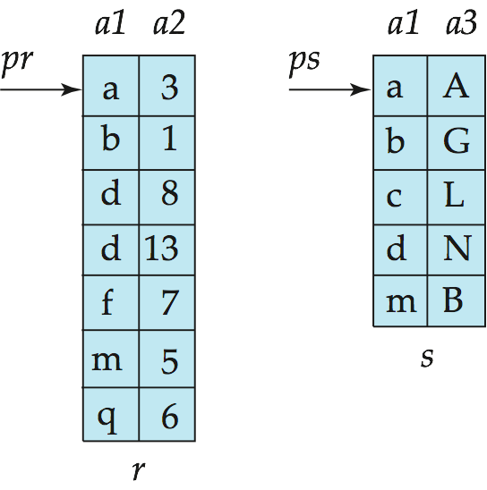
Merge-Join
Sort both relations on their join attribute (if not already sorted on the join attributes).
Merge the sorted relations to join them
  Join step is similar to the merge stage of the sort-merge algorithm.
  Main difference is handling of duplicate values in join attribute — every pair with same value on join attribute must be matched
  Detailed algorithm in book

Slide 20
Merge-Join (Cont.)
Can be used only natural joins
Each block needs to be read only once (assuming all tuples for any given value of the join attributes fit in memory)
Thus, the cost of merge join is:
b_{r} + b_{s} block transfers + ⎡b_{r} / b_{b}⎤ + ⎡b_{s} / b_{b}⎤ seeks
  + the cost of sorting if relations are unsorted.
hybrid merge-join: If one relation is sorted, and the other has a secondary B⁺-tree index on the join attribute
  Merge the sorted relation with the leaf entries of the B⁺-tree .
  Sort the result on the addresses of the unsorted relation’s tuples
  Scan the unsorted relation in physical address order and merge with previous result, to replace addresses by the actual tuples
    Sequential scan more efficient than random lookup

Slide 21
Hash-Join
Applicable for natural joins.
A hash function h is used to partition tuples of both relations
The hash function h maps JoinAttrs values to {0, 1, ..., n}, where JoinAttrs denotes the common attributes of r and s used in the natural join.
  r₀, r₁, . . ., r_{n} denote partitions of r tuples
    Each tuple t_{r} ∈ r is put in partition r_{i} where i = h(t_{r} [JoinAttrs]).
  r₀,, r₁. . ., r_{n} denotes partitions of s tuples
    Each tuple t_{s} ∈s is put in partition s_{i}, where i = h(t_{s} [JoinAttrs]).
Note -- in the book:
  r_{i} is denoted as H_{ri}
  s_{i} is denoted as H_{si}
  n is denoted as n_{h.}

Slide 22
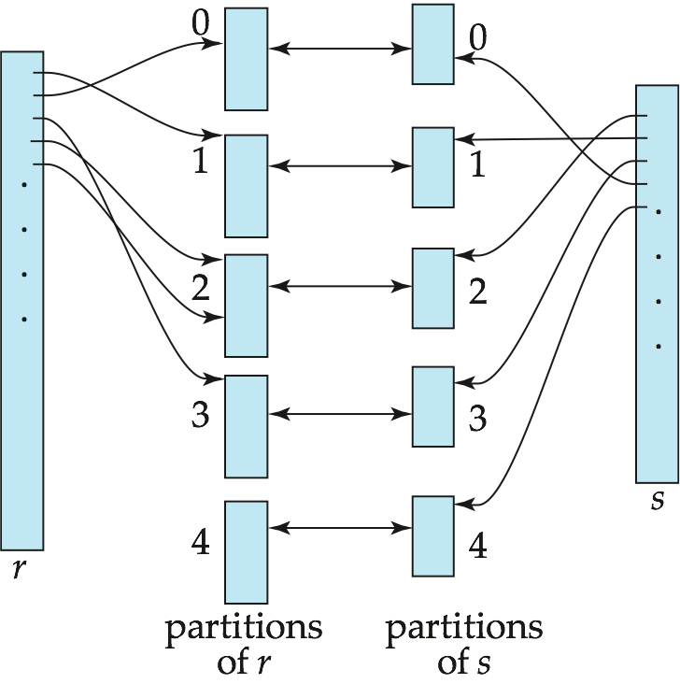
Hash-Join (Cont.)

Slide 23
Hash-Join (Cont.)
The relation r tuples in r_{i} need only to be compared with the relation s tuples in s_{i}
Need not be compared with s tuples in any other partition, since:
  An r tuple and an s tuple that satisfy the join condition will have the same value for the join attributes.
  If that value is hashed to some value i, the r tuple has to be in r_{i} and the s tuple in s_{i}.

Slide 24
Hash-Join Algorithm
The hash-join of r and s is computed as follows.
1. Partition the relation s using hashing function h. When partitioning a relation, one block of memory is reserved as the output buffer for each partition.
2. Partition r similarly.
3. For each i:
  Load s_{i} into memory and build an in-memory hash index on it using the join attribute. This hash index uses a different hash function than the earlier one h.
  Read the tuples in r_{i} from the disk one by one. For each tuple t_{r} locate each matching tuple t_{s} in s_{i} using the in-memory hash index. Output the concatenation of their attributes.
Relation s is called the build input and r s called the probe input.

Slide 25
Hash-Join algorithm (Cont.)
The value n and the hash function h is chosen such that each s_{i} should fit in memory.
  Typically n is chosen as ⎡b_{s}/M⎤ * f where f is a “fudge factor”, typically around 1.2
  The probe relation partitions s_{i} need not fit in memory
Recursive partitioning required if number of partitions n is greater than number of pages M of memory.
  Instead of partitioning n ways, use M – 1 partitions for s
  Further partition the M – 1 partitions using a different hash function
  Use same partitioning method on r
  Rarely required: e.g., with block size of 4 KB, recursive partitioning not needed for relations of < 1GB with memory size of 2MB, or relations of < 36 GB with memory of 12 MB

Slide 26
Handling of Overflows
Partitioning is said to be skewed if some partitions have significantly more tuples than some others
Hash-table overflow occurs in partition s_{i} if s_{i} does not fit in memory. Reasons could be
  Many tuples in s with same value for join attributes
  Bad hash function
Overflow resolution can be done in build phase
  Partition s_{i} is further partitioned using different hash function.
  Partition r_{i} must be similarly partitioned.
Overflow avoidance performs partitioning carefully to avoid overflows during build phase
  E.g. partition build relation into many partitions, then combine them
Both approaches fail with large numbers of duplicates
  Fallback option: use block nested loops join on overflowed partitions

Slide 27
Cost of Hash-Join
If recursive partitioning is not required: cost of hash join is
3(b_{r} + b_{s}) +4 ∗ n_{h} block transfers +
2( ⎡b_{r} / b_{b}⎤ + ⎡b_{s} / b_{b}⎤) seeks
If recursive partitioning required:
  number of passes required for partitioning build relation
  s is ⎡log_{M–1}(b_{s}) – 1⎤
  best to choose the smaller relation as the build relation.
  Total cost estimate is:
  2(b_{r} + b_{s}) ⎡log_{M–1}(b_{s}) – 1⎤ + b_{r} + b_{s} block transfers +
  2(⎡b_{r} / b_{b}⎤ + ⎡b_{s} / b_{b}⎤) ⎡log_{M–1}(b_{s}) – 1⎤ seeks
If the entire build input can be kept in main memory no partitioning is required
  Cost estimate goes down to b_{r} + b_{s}.

Slide 28
Example of Cost of Hash-Join
instructor teaches
Assume that memory size is 20 blocks
b_{instructor}= 100 and b_{teaches} = 400.
instructor is to be used as build input. Partition it into five partitions, each of size 20 blocks. This partitioning can be done in one pass.
Similarly, partition teaches into five partitions,each of size 80. This is also done in one pass.
Therefore total cost, ignoring cost of writing partially filled blocks:
  3(100 + 400) = 1500 block transfers +
  2( ⎡100/3⎤ + ⎡400/3⎤) = 336 seeks

Slide 29
End of Module 13

